Slide 1

United States Space Force
menu

Slide 2
United States Space Force
search
menu

Slide 3
United States Space Force
menu
home
parents + family
current space cadets
future space cadets
getting started
recruiting stations
videos
sign in

Slide 4
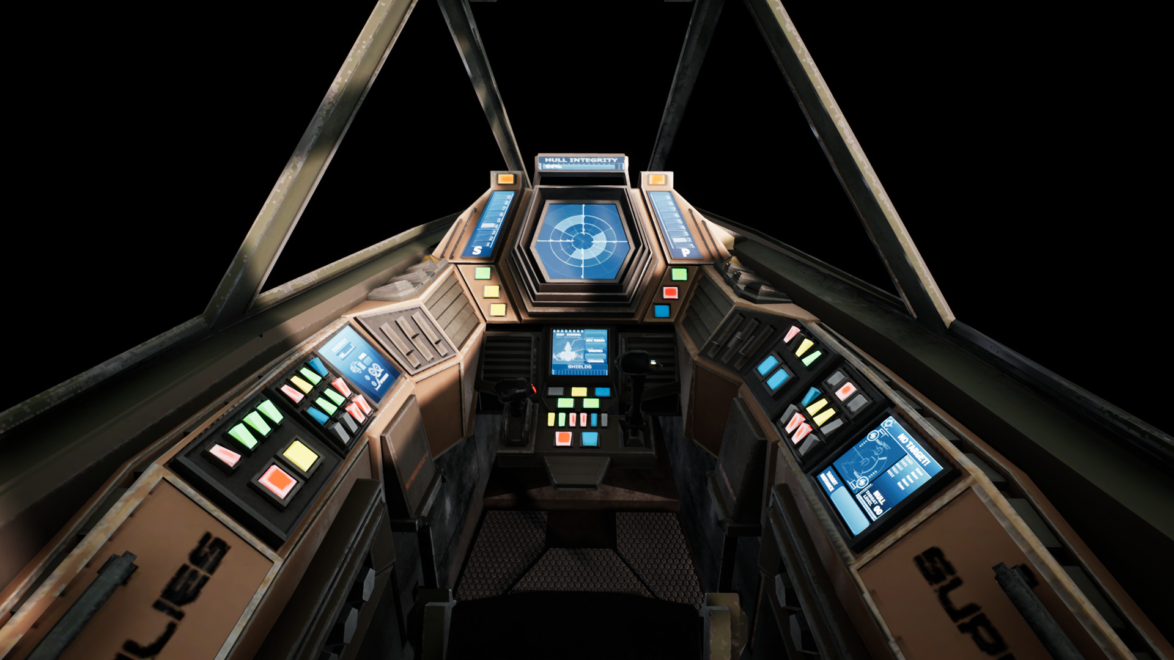

United States Space Force
menu
Join the Fight
Sign-up Information and Resources
A Career that Matters

Slide 5
United States Space Force
menu
Join the Fight
A Career that Matters
Our Mission

Slide 6
United States Space Force
menu
Join the Fight
A Career that Matters
Our Mission

Slide 7
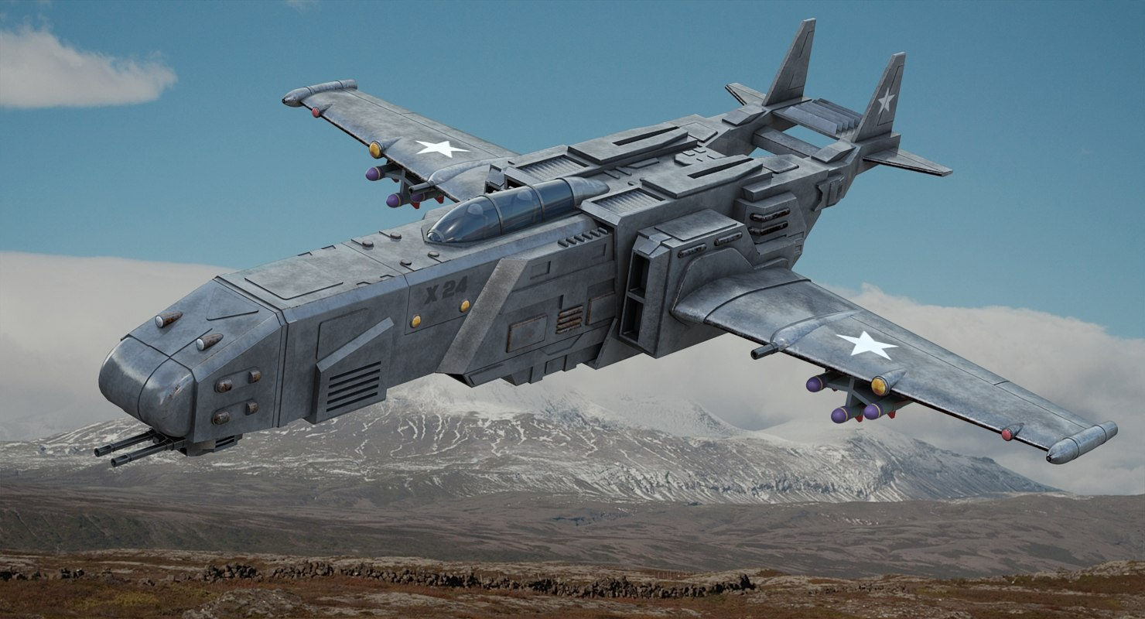
United States Space Force
menu
A Career that Matters
Never Miss a Family Holiday!*
Lifestyle

Slide 8

United States Space Force
menu
Never Miss a Family Holiday!*
Earn an Education that’s Out of this World!
Benefits

Slide 9

United States Space Force
menu
Earn an Education that’s Out of this World!
Never Miss a Family Holiday!*
We want you in the Space Force Crew!
Sign-up Form

Slide 10




United States Space Force
menu
We want you in the Space Force Crew!
Sign-up Form
How to join
Our Mission
Lifestyle
Benefits
Sign-up Form
twitter
Find A Recruiter
Chat Live
Parents and Family
Personal Career Assessment
Videos
facebook
youtube
instagram
Privacy Policy About Our Ads Site Map Terms of Use FAQ SF Links

Slide 11

United States Space Force
menu
We want you in the Space Force Crew!
Sign-up Form
How to join
Our Mission
Lifestyle
Benefits
Sign-up Form
twitter
Find A Recruiter
Chat Live
Parents and Family
Personal Career Assessment
Videos
facebook
youtube
instagram
Privacy Policy About Our Ads Site Map Terms of Use FAQ SF Links

Slide 12

United States Space Force
menu
Getting Started
Meet with a recruiter
Take the ASVAB
Choose your career
Become a Space Cadet
Whether you’re entering the Space Force as enlisted or an officer, there are a lot of factors that will shape your journey, including your unique background, current situation and goals for the future. We’ll help you determine the best path for you and figure out what steps you need to take to get your Space Force career started.
Find a recruiting office near you
Chat live

Slide 13
United States Space Force
menu
What is the ASVAB?
The ASVAB is a series of tests developed by the Department of Defense and is used by the U.S. Space Force to determine whether you have the mental aptitude to enlist. The ASVAB also helps determine which Military Occupational Specialties (MOS) you qualify for. The ASVAB is required to enlist in the U.S.S.F. and is valid for two years. The ASVAB may be given in a computerized version at a Military Entrance Processing Station (MEPS) or in a paper version at various Military Entrance Test (MET) sites around the country or at high schools and colleges.
ASVAB TEST AREAS
General Science - measures knowledge of life science, earth and space science, and physical science
Arithmetic Reasoning - measures ability to solve basic arithmetic word problems
Word Knowledge - measures ability to understand the meaning of words through synonyms
Paragraph Comprehension - measures ability to obtain information from written material
Mathematics Knowledge - measures knowledge of mathematical concepts and applications
Electronics Information - measures knowledge of electrical current, circuits, devices and electronic systems
Auto and Shop Information - measures knowledge of automotive maintenance and repair, and wood and metal shop practices
Mechanical Comprehension - measures knowledge of the principles of mechanical devices, structural support and properties of materials
Assembling Objects - measures ability with spatial relationships

Slide 14
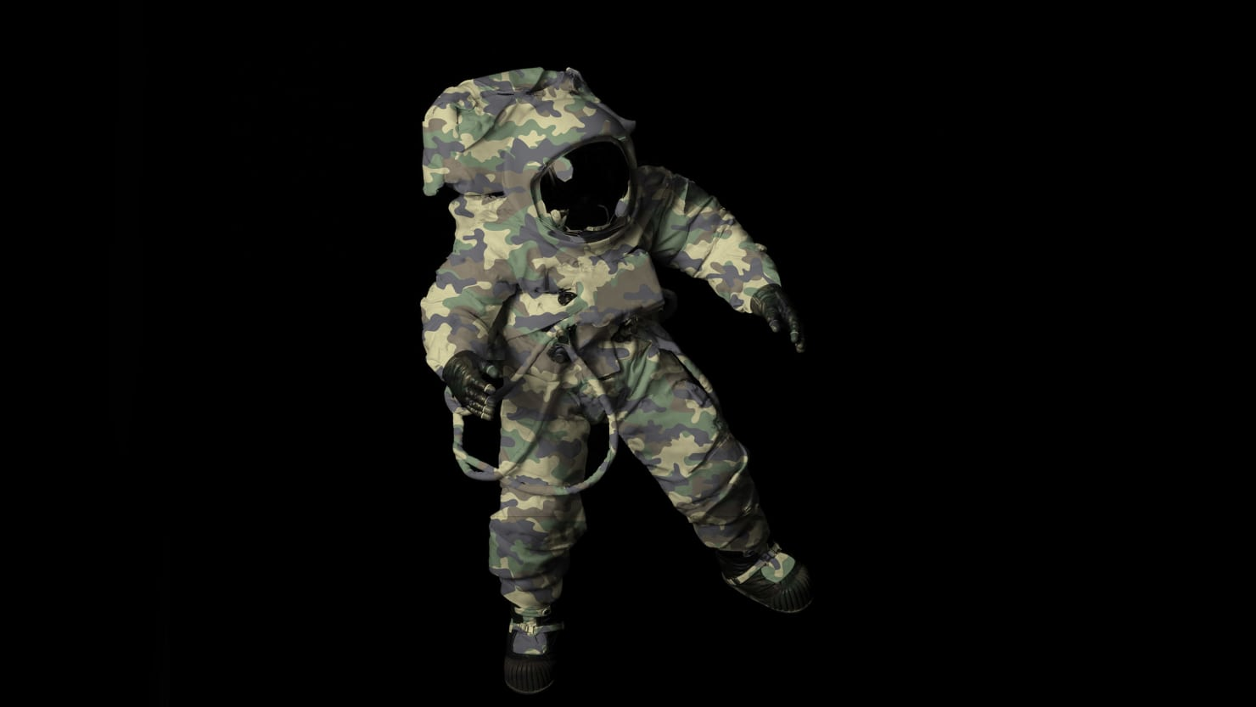
United States Space Force
menu
material
Mathematics Knowledge - measures knowledge of mathematical concepts and applications
Electronics Information - measures knowledge of electrical current, circuits, devices and electronic systems
Auto and Shop Information - measures knowledge of automotive maintenance and repair, and wood and metal shop practices
Mechanical Comprehension - measures knowledge of the principles of mechanical devices, structural support and properties of materials
Assembling Objects - measures ability with spatial relationships
Be the Change

Slide 15
United States Space Force
menu
We want you in the Space Force Crew!
Sign-up Form

Slide 16
United States Space Force
menu
We want you in the Space Force Crew!
Sign-up Form
How to join
Our Mission
Lifestyle
Benefits
Sign-up Form
twitter
Find A Recruiter
Chat Live
Parents and Family
Personal Career Assessment
Videos
facebook
youtube
instagram
Privacy Policy About Our Ads Site Map Terms of Use FAQ SF Links

Slide 17
United States Space Force
menu
Sign-Up Form
Thank you for your interest in the Space Force!
Please fill out the following form and a recruiter will be in touch soon!
First Name
Last Name
Address
Telephone

Slide 18
United States Space Force
menu
Thank you for your interest in the Space Force!
Please fill out the following form and a recruiter will be in touch soon!
First Name
Last Name
Age
Gender
Address
City
State
Zip Code
Email
Telephone

Slide 19
Thank you for your interest in the Space Force!
Please fill out the following form and a recruiter will be in touch soon!
United States Space Force
menu
First Name
Last Name
Age
Gender
Address
City
State
Zip Code
Email
Telephone
Submit
How to join
Our Mission
Lifestyle
Benefits
Sign-up Form
twitter
Find A Recruiter
Chat Live
Parents and Family
Personal Career Assessment
Videos
facebook
youtube
instagram
Privacy Policy About Our Ads Site Map Terms of Use FAQ SF Links

